Slide 1


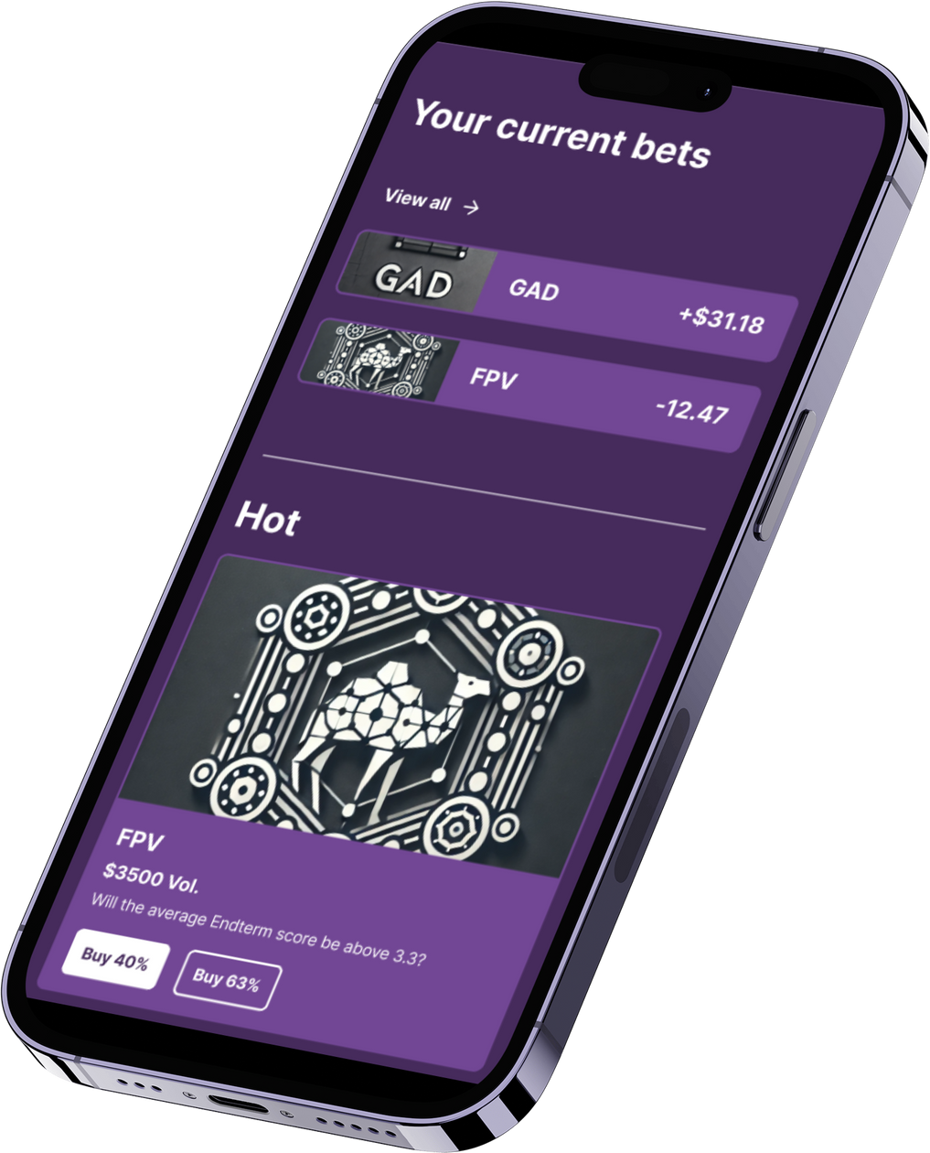
STUDYBet
Prediction market
Powered by Solana

Slide 2
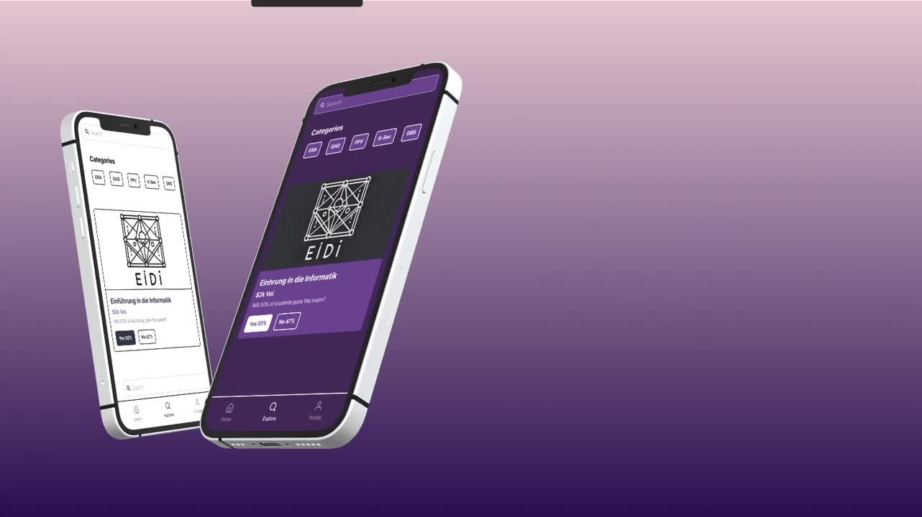

Slide 3

Agenda
TOPICS COVERED
Core Idea
Concept
Overview
App Preview
Implementation
Programming tools

Slide 4
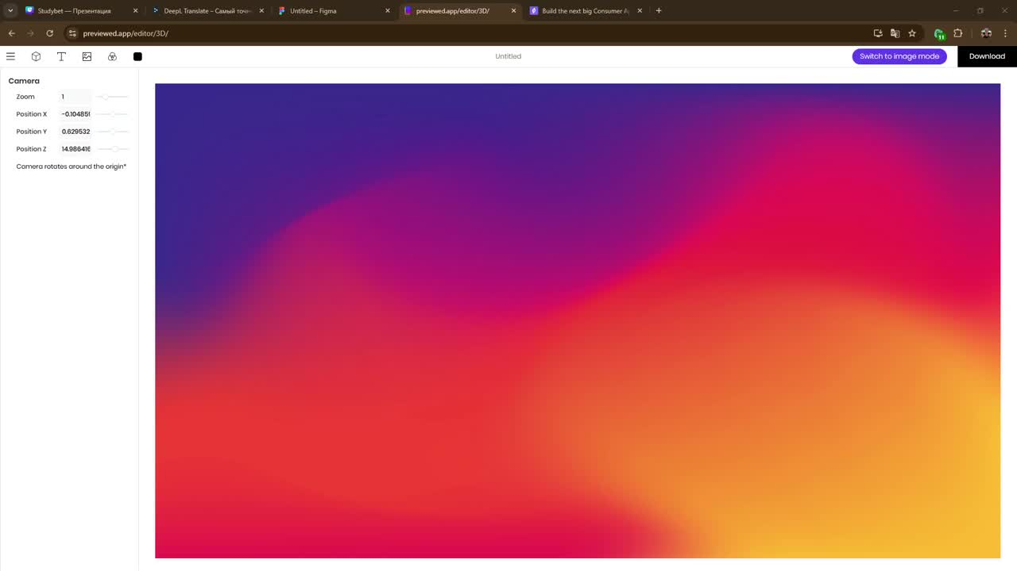

Slide 5
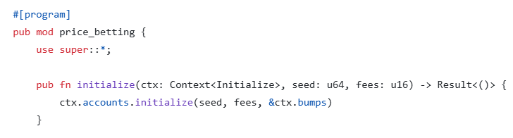

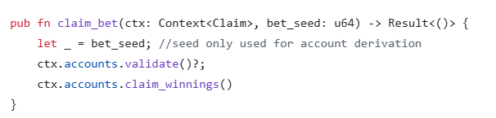
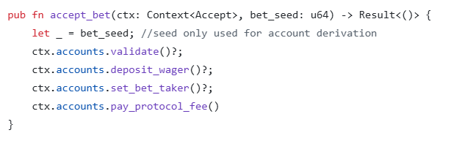

Slide 6

Thank you!

